Slide 1





Crypto Predictions
Zachary Griffin
Allison Brown

Slide 2

The Rollercoaster Value of Crypto
In the next slide, you can see how the four cryptocurrencies have skyrocketed their value in over the course of their lifespan. Currencies like Bitcoin started off at $0.8 by the end of its first month on the market and went to over $68,000 in November of 2021.
Throughout its life, however, it has seen dramatic highs and lows. We have chosen the cryptocurrencies of Ethereum, Bitcoin, Doge and ATOM because they are distinctive in several ways, and we want to predict what direction crypto will go in based on their value.

Slide 3
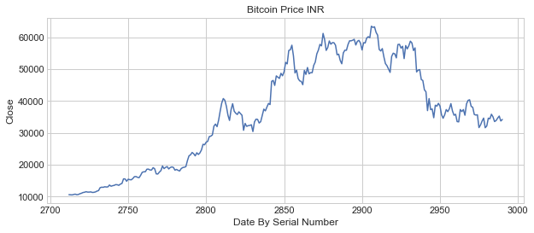
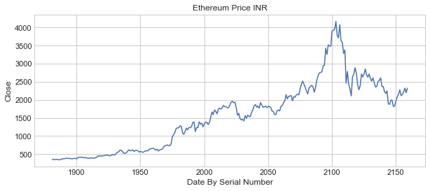
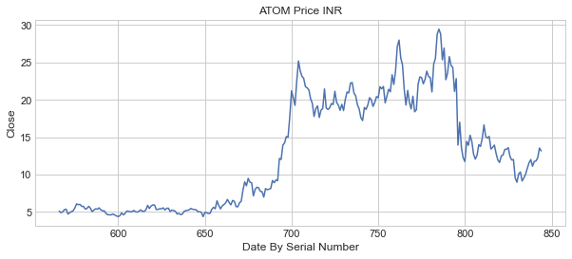
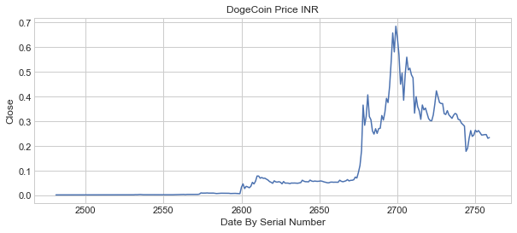
Bitcoin
Ethereum
Cosmos
Doge

Slide 4
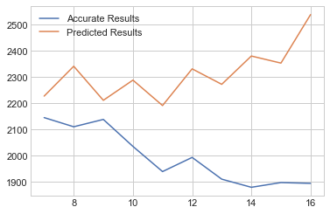
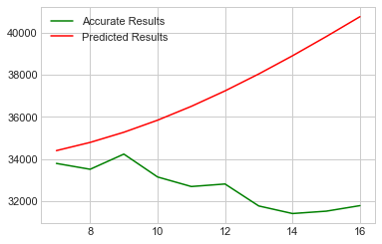
Predicting the Future Value of Crypto
Using modules such as AutoTS and SKlearn, we were able to create predictions that span the following ten days from the end of the dataset for each crypto.
The objective was to measure how close these predictions are to real data pulled from another dataset.
Using different datasets for each currency, it was discovered that the python predictions did not match well with the real results from July of 2021.
Ethereum
Bitcoin

Slide 5
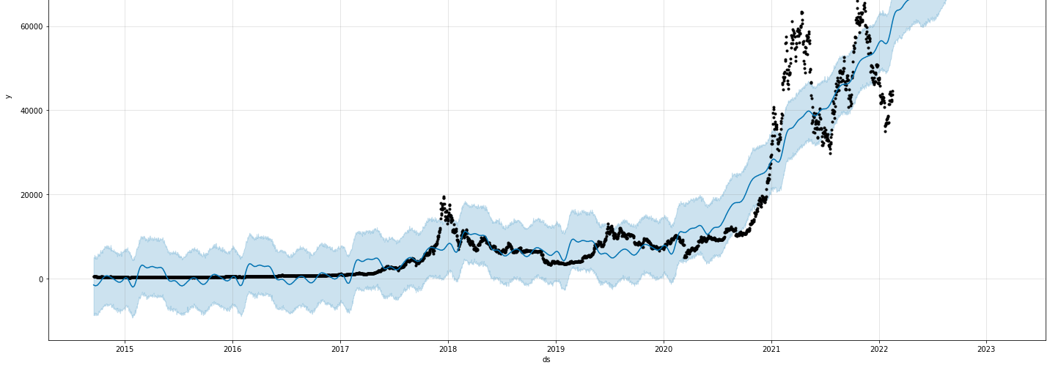
To ensure the predicted data being so far off isn’t a result of the module, we also used fbprophet to compare real data to predicted data. In this case, it also seemed a bit “off.”
It is worth pointing out that in July of 2021, which is where the other datasets ended, a lot of events such as the assassination of the Haitian president and the ongoing pandemic may have affected crypto prices which could explain the erratic graph results.

